Slide 1
Assignment 2
Socket Programming
Prof. Ai-Chun Pang
TA / Ping-Yu Yang, Wen-Hsin Wu, Kuang-Hui Huang

Slide 2
Socket Programming Tutorial

Slide 3
What is Socket?
Socket is the API for the TCP/IP protocol stack.
Provides communication between the Application layer and Transport layer.
Make internet communication like a file descriptor.
read() and write()
We will provide sample codes for you.
Application
Socket
Transport
Network
Link
Physical

Slide 4
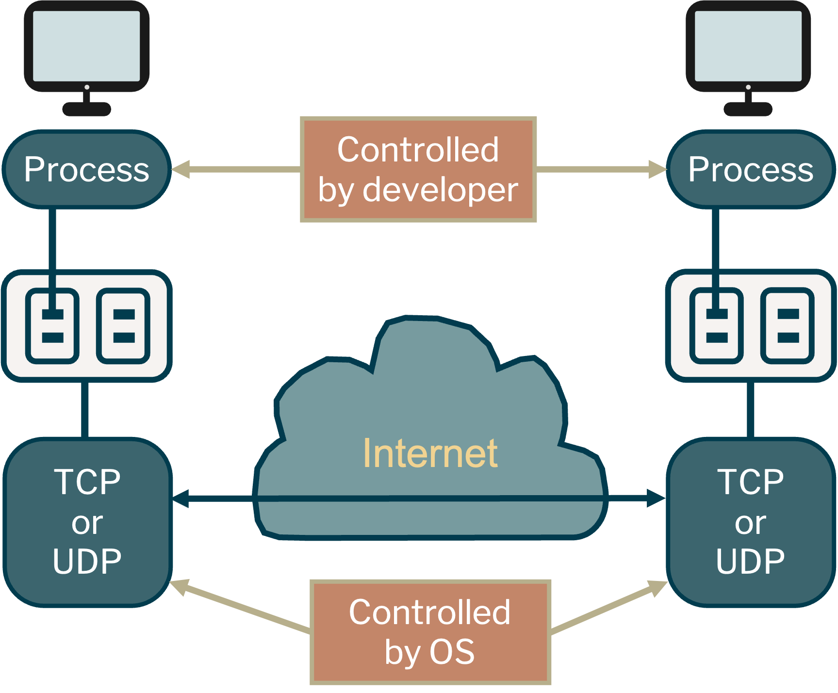
What is Socket?

Slide 5
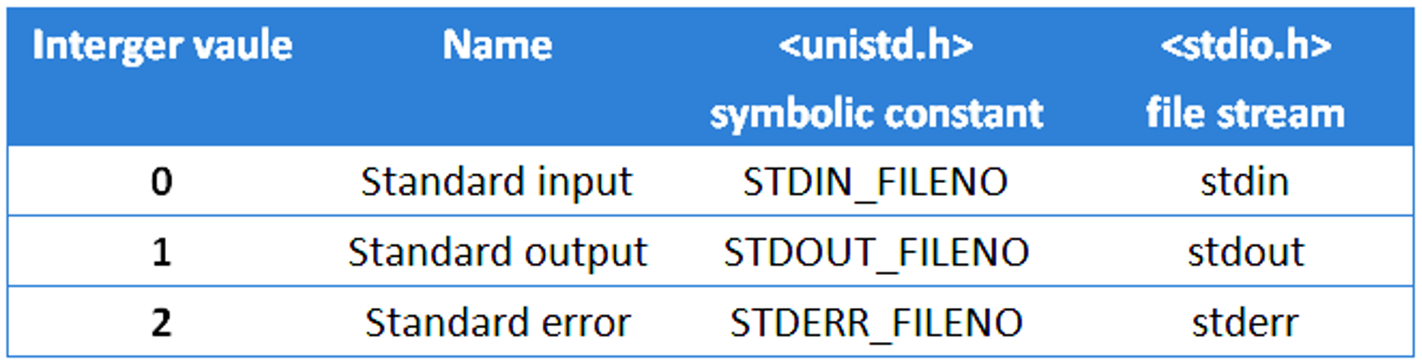
File Descriptors
When we open an existing file or create a new file, the kernel returns a file descriptor to the process.
If we want to read or write a file, we can access it through the file descriptor.
Socket in C use file descriptors to send and receive data.
int fd = open(“example.txt”, O_WRONLY | O_CREAT | O_TRUNC);
char *text = “Happy coding time\n”;
write(fd, text, strlen(text));
close(fd);
char *buf[1024];
read(0, buf, 1024);

Slide 6
TCP Service
TCP (Transmission Control Protocol)
Connection-oriented
Reliable transport
Flow control
Congestion control
What is Socket-Address?
IP address + Port number
IP address: To find out the machine (Network Layer)
Port number: To find out the process (Transport Layer)

Slide 7
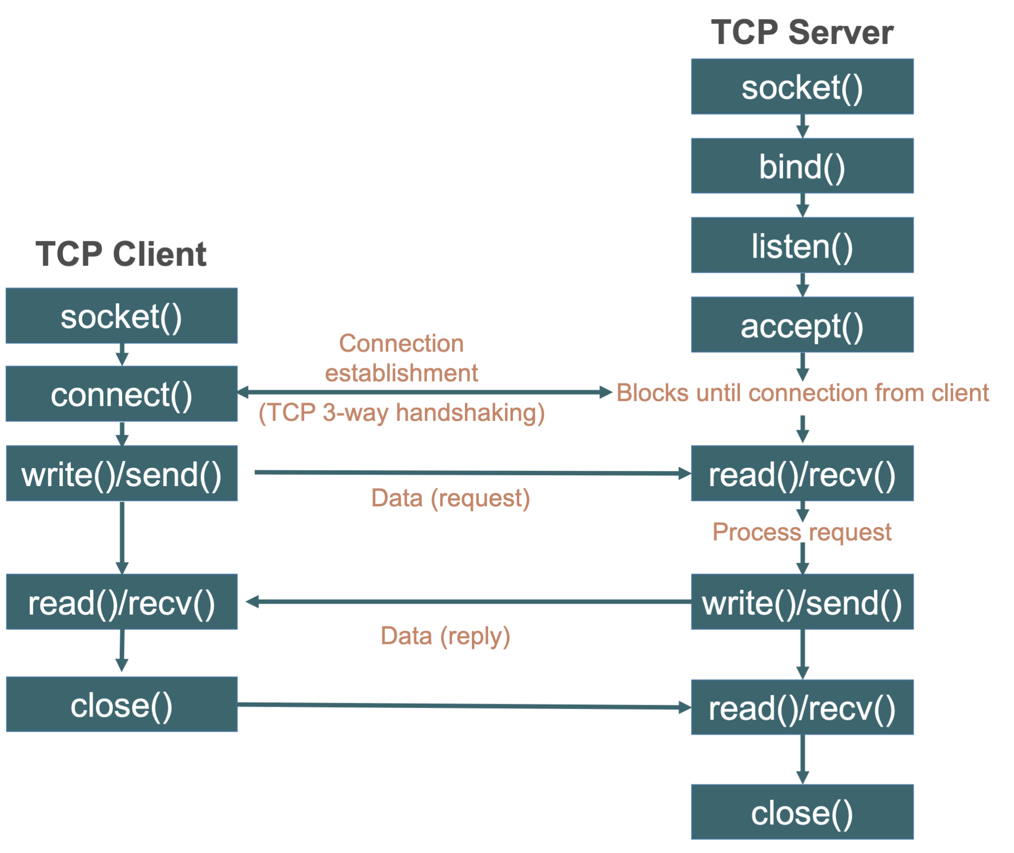
TCP Socket Flow Chart
Socket uses blocking I/O by default.

Slide 8
socket()
Create the endpoint for connection.
domain
AF_UNIX/AF_LOCAL: communication between 2 processes on a host. So they can share a file system.
AF_INET, AF_INET6: communication between processes on different hosts through the Internet. AF_INET is for IPv4, whereas AF_INET6 is for IPv6.
#include <sys/socket.h>
int socket (int domain, int type, int protocol);

Slide 9
socket()
Create the endpoint for connection.
type
SOCK_STREAM: sequential and connection-oriented (TCP)
SOCK_DGRAM: datagram (UDP)
protocol: defined in /etc/protocols, usually set to 0
return: file descriptor (int)
#include <sys/socket.h>
int socket (int domain, int type, int protocol);

Slide 10
bind()
Bind the address to the socket.
sockfd: specifies the socket file descriptor to bind.
addr
specifies the socket address to be associated with the sockfd
You can use “struct sockaddr_in*” defined in <netinet/in.h>, and then cast it into “struct sockaddr*”
len: specifies the size of sockaddr (= sizeof(struct sockaddr) )
#include <sys/socket.h>
int bind (int sockfd, struct sockaddr *addr, socklen_t len);
Notes:
include arpa/inet.h 會同時 include netinet/in.h 這個 header file

Slide 11
bind()
struct sockaddr_in {
short sin_family; // address family. EX:AF_INET
unsigned short sin_port; // port number for network
struct in_addr sin_addr; // IP address for network
unsigned char sin_zero[8]; // pad to sizeof(struct sockaddr)
}

Slide 12
listen()
Specify a socket to listen for connections.
sockfd: specifies the socket file descriptor to listen.
backlog: specifies the number of users allowed in queue.
#include <sys/socket.h>
int listen (int sockfd, int backlog); // returns 0 if it’s success; -1 otherwise
Notes:
Linux typically adds 3 to the number specified, while other OS has different implementations. (?)

Slide 13
accept()
Accept the connection on a socket.
sockfd: specifies the socket being listened to.
addr: pointer to the sockaddr. It will be filled in with the address of the peer socket.
Blocking until a user connect() call is received.
After accepting the connection, it creates a new file descriptor for the client. The original socket is not affected.
#include <sys/socket.h>
int accept (int sockfd, struct sockaddr *addr, socklen_t *addrlen);

Slide 14
connect()
Connect to the socket from client to server.
The format is the same as bind().
#include <sys/socket.h>
int connect (int sockfd, struct sockaddr *addr, socklen_t len);

Slide 15
close()
Close the file descriptor.
#include <unistd.h>
int close (int sockfd); // returns 0 if it’s success; -1 otherwise

Slide 16
read()/recv()
Read data from the socket file descriptor.
fd: specifies the socket file descriptor to read data from.
buf: specifies the buffer to contain the received data.
count/len: specifies the size to receive.
flag: (read() has no this parameter.) It’s about some details like blocking/nonblocking.
#include <unistd.h>
ssize_t read (int fd, void *buf, size_t count);
ssize_t recv (int fd, void *buf, size_t len, int flag);

Slide 17
read()/recv()
Read data from the socket file descriptor.
Reading data from a file may be
Successful, return the number of bytes received
EOF. (end of file) (i.e., return = 0)
Failed, errno is set to indicate the error.
It may be blocked. (block I/O).
#include <unistd.h>
ssize_t read (int fd, void *buf, size_t count);
ssize_t recv (int fd, void *buf, size_t len, int flag);

Slide 18
write()/send()
Write data to socket file descriptor.
fd: specifies the socket file descriptor to send data to.
buf: specifies the buffer to contain the data to be transmitted.
count/len: specifies the size to send.
flag: (write() has no this parameter.) It’s about some details.
#include <unistd.h>
ssize_t write (int fd, const void *buf, size_t count); ssize_t send (int fd, const void *buf, size_t len, int flags);

Slide 19
write()/send()
Write data to socket file descriptor.
Writing data to file may be
Successful, return the number of bytes written.
Failed, errno is set to indicate the error.
It may be blocked. (block I/O)
#include <unistd.h>
ssize_t write (int fd, const void *buf, size_t count); ssize_t send (int fd, const void *buf, size_t len, int flags);

Slide 20
Useful Functions
Address and port numbers are stored as integers.
Different machines implement different endian.
They may communicate with each other on the network.
Converting IP address and port number.
htonl(): for IP address (host -> network)
ntohl(): for IP address (network -> host)
htons(): for port number (host -> network)
ntohs(): for port number (network -> host)

Slide 21
Useful Functions
An IP address is usually hard to remember.
We need to translate the hostname to IP address.
Translate a hostname to IP address.
#include <netdb.h>
struct hostent *gethostbyname (const char *name);

Slide 22
select()
select() provides you to supervise multiple sockets, telling you which is able to read or write, etc.
With select(), it is possible to achieve Asynchronous Blocking I/O.
If you want to implement this assignment with select(), please refer to this website.

Slide 23
select()
Monitor whether there is at least one fd available.
nfds: specifies the number of file descriptors to monitor.
readfds: specifies the pointer to read file descriptor list.
writefds: specifies the pointer to write file descriptor list.
exceptfds: specifies the pointer to the error file descriptor list.
timeout: deadline for select().
#include <unistd.h>
int select (int nfds, fd_set*, readfds, fd_set* writefds, fd_set* exceptfds, struct timeval* timeout);

Slide 24
select()
FD_SET(): Add the file descriptor into the set.
FD_CLR(): Remove the file descriptor from the set.
FD_ISSET(): Check if the file descriptor is available.
FD_ZERO(): Clear the set.
void FD_SET (int fd, fd_set *set);
void FD_CLR (int fd, fd_set *set);
int FD_ISSET (int fd, fd_set *set); // return: 1 if it’s available, else: 0
void FD_ZERO (fd_set *set);

Slide 25
poll()
Monitor whether there is at least one fd available.
fds: specifies the pointer to file descriptor list.
nfds: specifies the number of file descriptors to monitor.
timeout: deadline for poll().
select() can monitor only file descriptors numbers that are less than FD_SETSIZE (1024)—an unreasonably low limit for many modern applications. All modern applications should instead use poll() or epoll().
#include <unistd.h>
int poll(struct pollfd *fds, nfds_t nfds, int timeout);

Slide 26
Reference
Beej’s Guide to Network Programming (中文)
Beej’s Guide to Network Programming (English)
Linux manual page

Slide 27
HyperText Transfer Protocol Tutorial

Slide 28
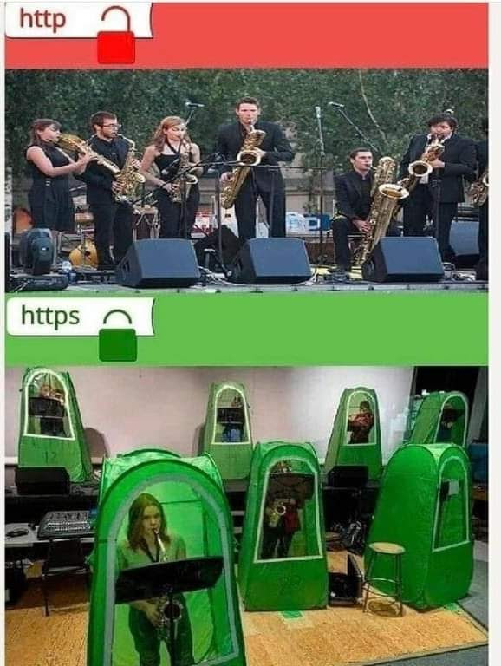
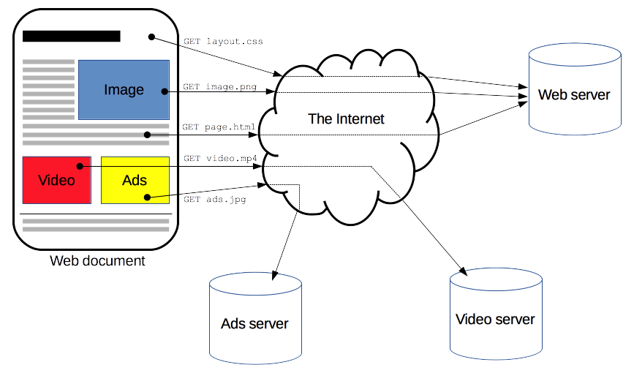
What is HTTP?
HTTP is an stateless application layer protocol using TCP (before HTTP/3).
A request–response protocol in the client–server model.
HTTP is designed for sharing multimedia resources.
Default TCP port is 80. (https: 443)

Slide 29
Message Format
HTTP messages are how data is exchanged between a server and a client. There are two types of messages:
Request: sent by the client to trigger an action on the server
Response: the answer from the server
HTTP requests and responses, share similar structure and are composed of start-line, headers, blank line, body(optional)
Newline
In the HTTP 1.1 protocol, information is separated using the CRLF (\r\n), not a single LF (\n).

Slide 30
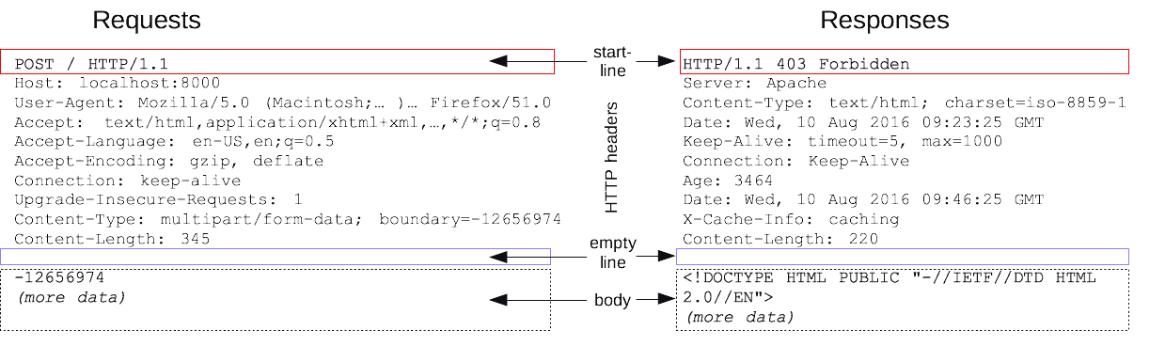
Message Format
HTTP requests and responses, share similar structure and are composed of start-line, headers, blank line, body(optional)

Slide 31
Try It Yourself: HTTP Requests
You can run the command below to send an http request to example.com
It will send something like:
Exercise: Modify client.c to do the same thing above.
$ echo -en "GET / HTTP/1.1\r\nHost: example.com\r\nConnection: Close\r\n\r\n" | nc example.com 80
GET / HTTP/1.1\r\n
Host: example.com\r\n
Connection: Close\r\n
\r\n

Slide 32
Try It Yourself: HTTP Responses
Modify the code in the example code, server.c, setting PORT to 8080, and the message:
Exercise: How can we keep the server handle new connections?
char *message = "HTTP/1.1 200 OK\r\n"
"Content-Length: 21\r\n"
"Content-Type: text/html\r\n\r\n"
"<h1>Hello World!</h1>";

Slide 33
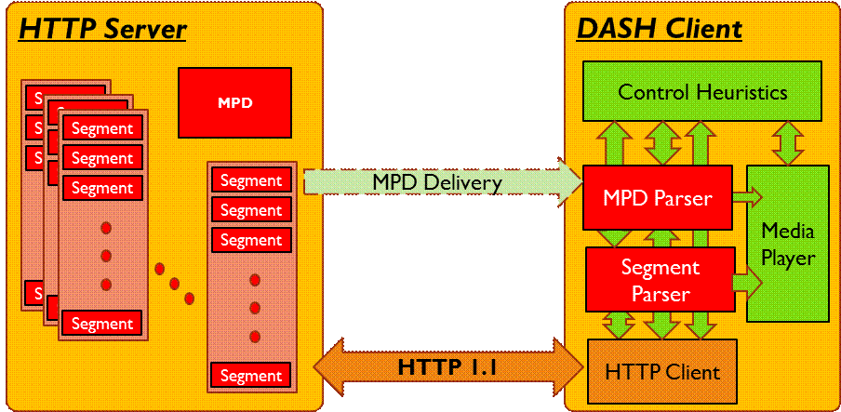
MPEG-DASH
Dynamic Adaptive Streaming over HTTP
First adaptive bit-rate HTTP-based streaming solution
Enable high quality streaming of media content over the Internet delivered from conventional HTTP web servers

Slide 34
Assignment 2 Announcement

Slide 35
Environment Setup

Slide 36

Docker (Must use)
We provide a docker config (docker-compose.yml) for you to run our example code. If you use Windows, you will need to install Windows Subsystem Linux (WSL 2) first.
Please make sure you can compile and run your code well in the provided docker container.

Slide 37
Docker Installation
Windows
Install Windows Subsystem Linux (WSL): Guide
Install Docker Desktop
Ubuntu
Install Docker through your terminal: # apt update # apt install docker.io
macOS
Install Docker Desktop

Slide 38
Start Your Container
Clone repository to your host and run the container:
Port 8080/TCP is exposed on the host, allowing you to access your server from outside.
$ git clone <your_repository>
$ docker-compose up -d
$ ssh cn@localhost -p 2222

Slide 39
Your Tasks
In this assignment, you need to implement a simple HTTP server/client with the following functions:
Server can serve static web page index.html, uploadf.html, uploadv.html, etc.
Server can serve dynamic web pages listf.rhtml, listv.rhtml, player.rhtml, etc.
Server can serve text/binary files
Client can upload files and videos to server
Client can fetch files from server (including DASH videos)
Your server should be compatible with modern browser. (at least supporting browsers based on Chromium)
Notes:
admin:
列出所有使用者
加減黑名單 (client 不能使用所有功能)
如果 client 下載/上傳多個檔案中途被 block ，整個指令做完才生效
沒有 put get ls play
client:
照去年

Slide 40
Routes
We provide templates for these endpoints:
index.html
Your name and id
uploadf.html, uploadv.html
Upload page for files/videos
listf.rhtml, listv.rhtml
List all the videos/files on the server
player.rhtml
Video player

Slide 41
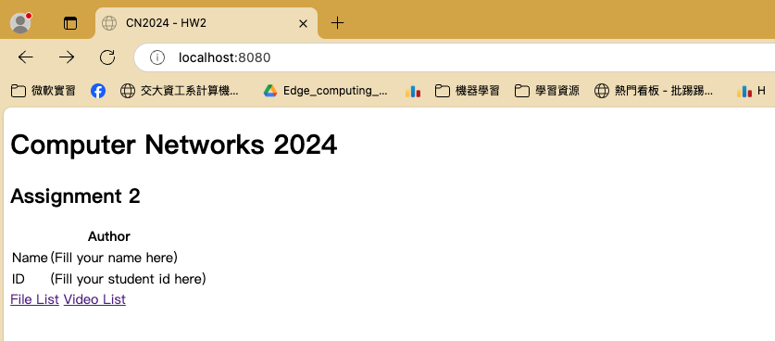
Routes: /
Using the provided template index.html. Fill your name and id in table.

Slide 42
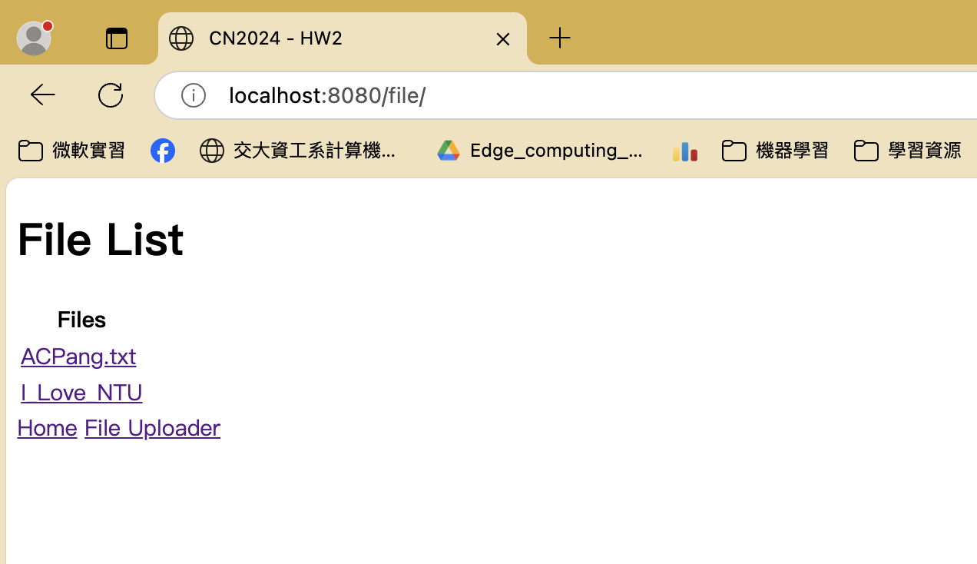
Routes: /file/
Using the provided template listf.rhtml. Shows all the files that the server has.

Slide 43
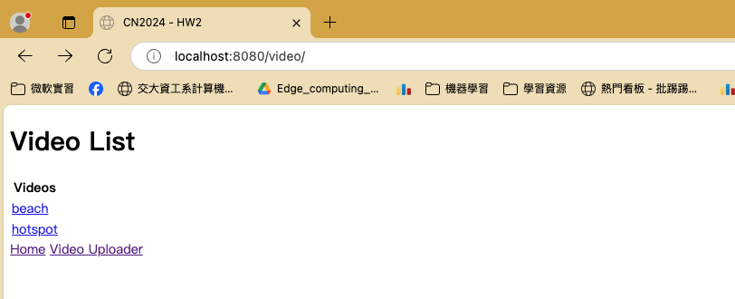
Routes: /video/
Using the provided template listv.rhtml. Shows all the videos that the server has.

Slide 44
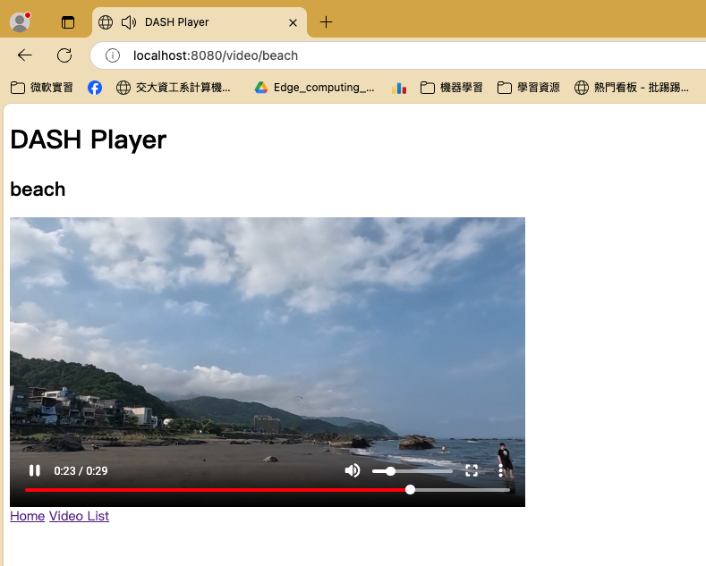
Routes: /video/{videoname}
Using the provided template player.rhtml to play videos.

Slide 45
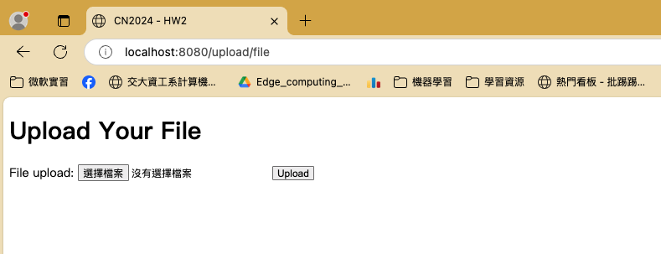
Routes: /upload/file & /api/file
Upload files to the server.

Slide 46
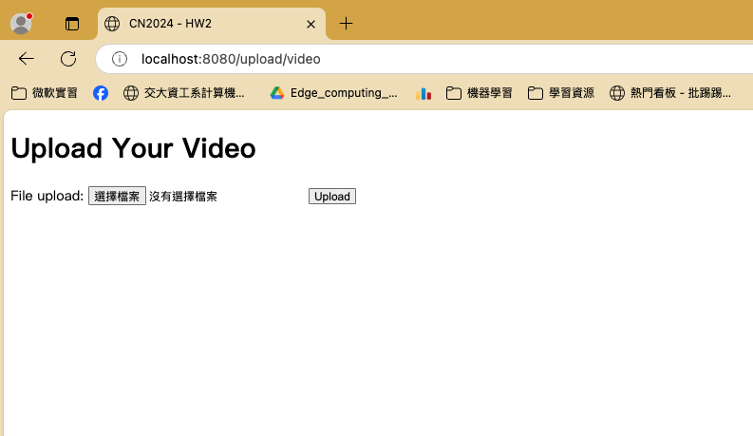
Routes: /upload/video & /api/video
Upload videos to the server.

Slide 47
Server Demo Time!

Slide 48
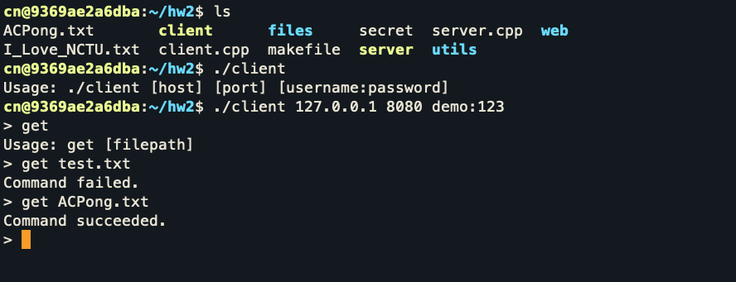
Commands: get {filepath}
Download files from the server.

Slide 49
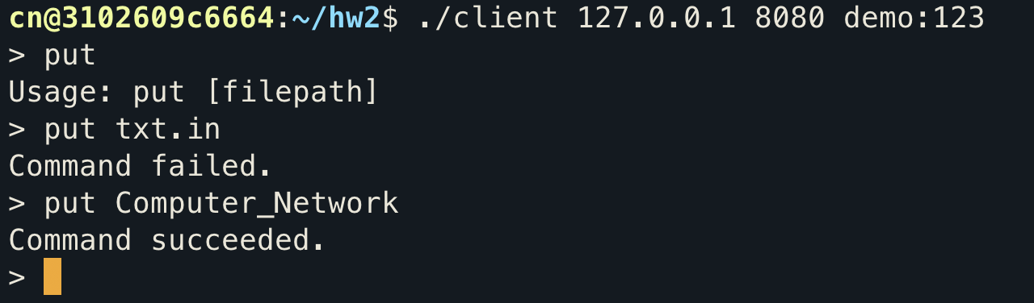
Commands: put {filepath}
Upload files to the server.

Slide 50
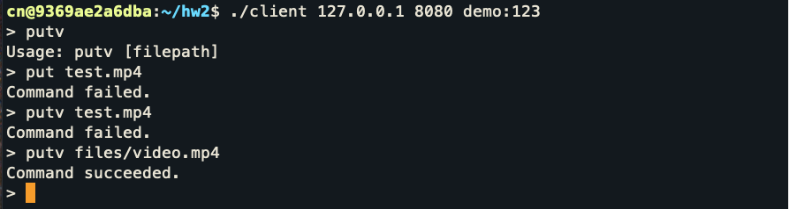
Commands: putv {filepath}
Upload videos to the server.

Slide 51
Client Demo Time!

Slide 52
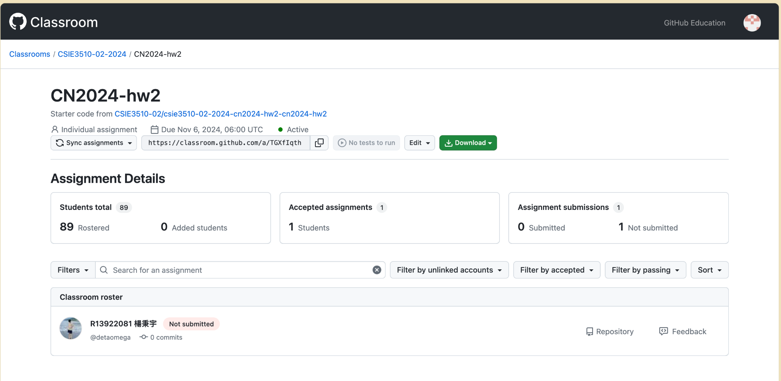
Github Classroom
Get the access of assignment materials via Github Classroom.
Notes:
交到 gradescope

Slide 53
Bonus
To better track everyone’s progress and improve this course, we encourage you to commit your codes to GitHub Classroom regularly after completing some parts of this assignment
Make sure your commit messages are meaningful.
You can decide whether to do the bonus part or not. If you want, please regularly (but not intensively) commit your codes to GitHub Classroom and answer the following questions in your report
How did you utilize Git for development in this assignment?
What benefits did it bring?
Is it a better way for you to submit homework via GitHub Classroom than via traditional ways (e.g, submit a .zip file to NTU Cool)? Why or Why not?
Once you join this part, we will give you a bonus of 5 points for Assignment 2

Slide 54
Submission
Report
Your report should be a pdf file. Submit it to Gradescope.
PDF file name: <studentID>_hw2.pdf
e.g., B11902999_hw2.pdf
Codes
Please push all the source code (i.e., without your report, the video file, and the execution file) to github classroom assigment.
The penalty for the wrong format is 10 points.
No plagiarism is allowed. A plagiarist will be graded zero.
Notes:
交到 gradescope

Slide 55
Submission
Deadline
Due Date : 14:00:00, November 6th, 2024
The penalty for late submission is 20 points per day.
Notes:
交到 gradescope

Slide 56
If You have any Problems…
You can
Ask questions on NTU COOL Discussion Forum
Send a mail to TA with the tag [HW2] in the title
Ask questions in TA hours in R438 by appointment. Google Sheet Link.
TA Email: ntu.cnta@gmail.com

Slide 57
Happy coding! ●ω●)ฅ
TA Email: ntu.cnta@gmail.com

